Slide 1

Farewise: Predictive Analytics for Taxi Pricing

Slide 2


Table of Contents
S.No | Topic
1. | PROBLEM STATEMENT
2. | INTRODUCTION
3. | ABSTRACT OF OUR PROPOSED SYSTEM
4. | SCOPE OF OUR PROJECT
5. | EXISTING SYSTEM
6. | PROPOSED SYSTEM

Slide 3
S.No | Topic
7. | ARCHITECTURE DESIGN
8. | SYSTEM DESIGN
9. | RESULTS
10. | FUTURE ENHANCEMENT
11. | CONCLUSIONS & REFERENCES

Slide 4
Problem statement
The problem at hand is to develop a predictive analytics system, named "FareWise," for taxi pricing that optimizes fare estimation, taking into account various factors, to provide accurate and fair pricing for taxi rides. The primary objective is to create a robust predictive model that can be used by taxi service providers to improve their fare pricing strategies and ensure a transparent and equitable experience for both passengers and drivers.

Slide 5
Introduction:
Taxi services have revolutionized the way people commute, providing a convenient and efficient alternative to traditional transportation methods. These services leverage technology to connect passengers with nearby drivers, offering a seamless and on-demand transportation experience. The concept gained prominence with the rise of smartphone apps and GPS technology, allowing users to easily request and track rides in real-time.
Farewise Taxi Pricing is an innovative solution designed to revolutionize the traditional taxi industry by leveraging the power of predictive analytics. In an era where data-driven insights are transforming various sectors, Farewise aims to bring a new level of efficiency and transparency to taxi pricing, benefiting both service providers and consumers.

Slide 6
Abstract of our Proposed System
The "FAREWISE PREDICTIVE ANALYTICS FOR TAXI PRICING" project aims to improve user experience and optimize business operations in the taxi industry by predicting fares based on various factors.
The system transforms raw data into meaningful features suitable for machine learning models, including distance calculation, timestamp extraction, day/night binary feature creation, weather conditions categorization, passenger count, and luggage presence.
These features are crucial for accurately predicting taxi fares, considering the temporal, geographical, and situational contexts of each trip.
The project emphasizes the importance of data-driven decision-making in the taxi industry, where factors like weather conditions, events, passenger count, and luggage presence can significantly impact pricing.
By leveraging predictive analytics and feature engineering, the project aims to enable taxi service providers to offer fair and competitive pricing while ensuring a superior customer experience.
The project not only enhances the taxi service industry but also serves as a valuable case study in data science and machine learning, aiming to improve fare prediction efficiency and accuracy.
KEYWORD: Predictive Analytics , Machine Learning, XGBoost , Fare Prediction , Feature Engineering

Slide 7
Scope of the Project
The project "Farewell Predictive Analytics for Taxi Pricing" aims to collect historical taxi ride data, transform it into meaningful features, and develop machine learning models for predicting taxi fares.
The project will use various modeling techniques and algorithms to identify the most accurate and efficient approach.
Data visualization will be used to communicate the insights gained from the analysis effectively. The project will provide actionable recommendations and insights based on the predictive models and analysis, such as dynamic pricing strategies, optimizing service during special events, or improving passenger experience.
Comprehensive documentation will be provided to ensure transparency and replicability.
The project will also address ethical considerations related to data privacy and fairness in pricing. Future work may identify opportunities for further research and development.

Slide 8
Existing System
In the realm of taxi fare prediction, the existing system relies heavily on data-driven methodologies and advanced analytics to enhance the accuracy of fare estimates. The foundational element of this approach lies in the extensive collection of historical taxi ride data, encompassing crucial details such as pick-up and drop-off locations, timestamps, distances covered, and corresponding fare amounts. Researchers further enrich this dataset by incorporating additional factors such as weather conditions, traffic patterns, and special events, creating a comprehensive and multifaceted input for predictive models. Feature engineering, a pivotal component of the existing system, involves the creation of new variables derived from the dataset, including temporal elements like time of day and day of the week, as well as spatial factors like traffic density and geographic locations.

Slide 9
Limitations:
Incomplete or Inaccurate Data: The accuracy of predictive models heavily relies on the quality of data. Incomplete or inaccurate information in historical taxi ride datasets can lead to flawed predictions.
Unpredictable Events: The system may struggle to account for unpredictable events such as sudden weather changes, road closures, or unexpected traffic incidents, which can significantly impact travel time and fares.
Dynamic Nature of Traffic: Real-time predictions may be hindered by the dynamic nature of traffic conditions, and the system may struggle to adapt quickly to sudden changes in the transportation environment.
Fairness Concerns: Predictive models may inadvertently perpetuate biases in pricing, leading to unfair outcomes for certain demographics or geographic areas

Slide 10
Proposed System
Feature engineering is the process of transforming raw data into features that are suitable for machine learning models. In other words, it is the process of selecting, extracting, and transforming the most relevant features from the available data to build more accurate and efficient machine learning models. In the context of this project, the goal is to engineer features that can capture the factors influencing taxi fares effectively.The summary outlines the process of calculating the distance between pickup and dropoff locations, extracting information from the timestamp, creating a binary feature for day/night, categorizing features like weather conditions, special events, and passenger count, and creating a binary feature for luggage, as these factors can impact fares. The summary also mentions the importance of determining the number of passengers and the impact of luggage on fares, as these factors can influence the overall cost.

Slide 11
Literature review
PAPER 1: An Automated Cost Prediction in Uber/Call Taxi Using Machine Learning Algorithm
Elizabeth Rani. G, Revanth Raj. R proposed that the model aims to improve the efficiency of taxi businesses like Uber, Ola, and Meru Cabs by predicting the lowest fare using a linear regression model. The model compares fare details for Uber Go, Go Sedan, and Uber Auto, and uses machine learning techniques to build an application that helps users select the best cab with the lowest fare, improving transport accessibility and reducing waiting times.
PAPER 2: Real Time Prediction of Cab Fare Using Machine Learning
T. Prem Jacob, A. Pravin proposed a model built to improve the efficiency of taxi businesses like Uber, Ola, and Meru Cabs by predicting the lowest fare using a linear regression model. The model compares fare details for Uber Go, Go Sedan, and Uber Auto, and uses machine learning techniques to build an application that helps users select the best cab with the lowest fare, improving transport accessibility and reducing waiting times.

Slide 12
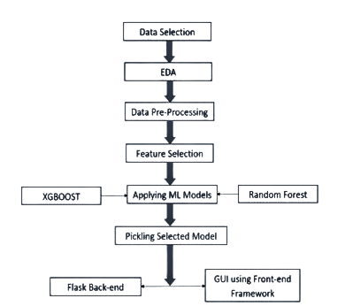
Architecture Design

Slide 13
System Design
SOFTWARE REQUIREMENTS
Language : Python
Platform : Anaconda, Jupyter Notebook
Tool : Forecasting
Operating System: windows 7 and above or Linux based OS or MAC OS.
HARDWARE REQUIREMENTS
RAM: 4 GB
Storage: 500 GB
CPU: 2 GHz or faster
Architecture: 32-bit or 64-bit

Slide 14
Result
The project "FareWise: Predictive Analytics for Taxi Pricing" has produced promising results in estimating taxi fares using a Gradient Boosting algorithm and feature engineering. The model's predictions were found to be within $3.60 of actual fares, with an R2 score of 0.85, indicating that 85% of the variance in fare amounts was explained by predictive features. The model outperformed a baseline model, demonstrating its practical utility. The interpretability of the model was achieved through SHAP values, revealing that distance between pick-up and drop-off locations was the most influential factor in fare predictions. This information can be valuable for transparency and user trust. However, the model has limitations, such as data quality and bias in fare predictions based on geographic location. Mitigating these biases is a challenge that the team is actively addressing. The practical implications of the predictive analytics model include improved fare estimates for taxi service providers, enhanced customer satisfaction, and operational efficiency. The model can assist in demand forecasting, optimize driver allocation, and reduce operational costs for taxi companies. Challenges include continuous monitoring and regular model updates, addressing scalability challenges during peak hours, and addressing bias and fairness. Ethical considerations include ensuring privacy and data security, handling sensitive passenger data securely, and addressing fairness concerns.

Slide 15
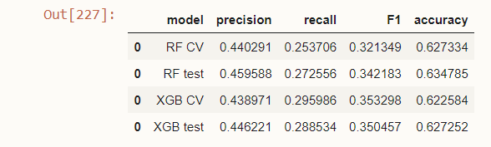
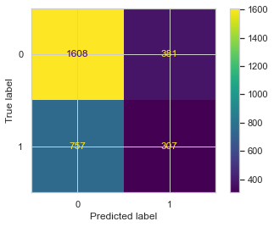
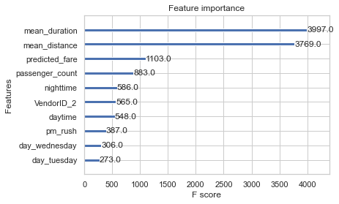
Output

Slide 16
Future Enhancement:
Enhancing the predictive model for taxi fare prices using the XGBoost algorithm presents exciting opportunities for future development. To improve the model's accuracy and responsiveness, one avenue of enhancement involves a comprehensive exploration of feature engineering. The integration of additional relevant features, such as real-time traffic conditions, special events, or even sentiment analysis of user reviews, can provide a more nuanced understanding of the dynamic factors influencing taxi fares.
Future enhancements for predicting taxi fare prices using the Random Forest algorithm offer exciting possibilities for refining and extending the predictive model. To enhance the accuracy of the model, additional feature exploration is a promising avenue. Introducing new features such as real-time weather updates, local events, or social factors can enrich the dataset, providing the model with a more comprehensive understanding of the variables influencing taxi fares.

Slide 17
Conclusion
In conclusion, the "FareWise" project has successfully delivered a predictive analytics system that significantly enhances the taxi pricing experience for both passengers and service providers. This project has represented a critical step in modernizing the taxi industry, harnessing the power of data and machine learning to offer more accurate and transparent fare predictions. The "FareWise" project is poised for further growth and improvement. Future enhancements will expand the system's capabilities to offer multi-platform support, real-time traffic data integration, route suggestions, and many other user-centric features. By embracing these future developments, "FareWise" will continue to provide value to its users and maintain its relevance in the ever-evolving transportation industry. In the coming years, we anticipate that "FareWise" will continue to serve as a valuable tool for both passengers and taxi service providers.

Slide 18
References
1. T. Kim, S. Sharda, X. Zhou and R. M Pendyala, "A stepwise interpretable machine learning framework using linear regression (LR) and long short-term memory (LSTM): City-wide demand-side prediction of yellow taxi and for-hire vehicle (FHV) service", Transportation Research Part C: Emerging Technologies, vol. 120, no. 102786, 2020.
2. Gunjan panda and Supriya p. panda, "Machine learning using exploratory analysis to predict cab fare", International Journal for Research in Applied Science & Engineering Technology (IJRASET), Aug 2019.
3. Bruce, S., "Issues in Fare Policy-the Case of the New York Taxi Industry," Transportation Research Board, 1998 Annual Meetings.
4. James, G, D Witten, T Hastie, and R Tibshirani, An introduction to statistical learning. Vol. 6. ,New York, Springer., 2013.
5. Weijie Wang 1 and Yanmin Lu , Analysis of the Mean Absolute Error (MAE) and the Root Mean Square Error (RMSE) in Assessing Rounding Model.

Slide 19
Thank You

